Slide 1

Computer graphics and gaming Project
By
Mehul Patil (SCETTYB303)
Niranjan Patil (SCETTYB305)

Slide 2
Aim: Develop a program to build a ping pong ball game using opengl and c++.

Slide 3
Objective:
Develop simple single player game
In game player have to avoid the ball getting hit the down wall.
If player unable to avoid collision of ball with the down wall using bottom bar in his side he lose one point.

Slide 4
Graphics object required for project
1. Top Bar (Rectangle) 2. Bottom Bar (Rectangle) 3. Ball (Circle)

Slide 5
Primitives and functions used for projects.
1. Top Bar : Shape of top bar is rectangle. For drawing rectangle we draw 4 vertices using GL_QUADS. For color effect we use glcolor command.
2. Bottom bar : Shape of bottom bar is also rectangle.For drawing rectangle we draw 4 vertices using GL_QUADS. For color effect we use glcolor command.
3. Ball : Shape of ball is Circle. For drawing circle we use glutSolidSphere command

Slide 6
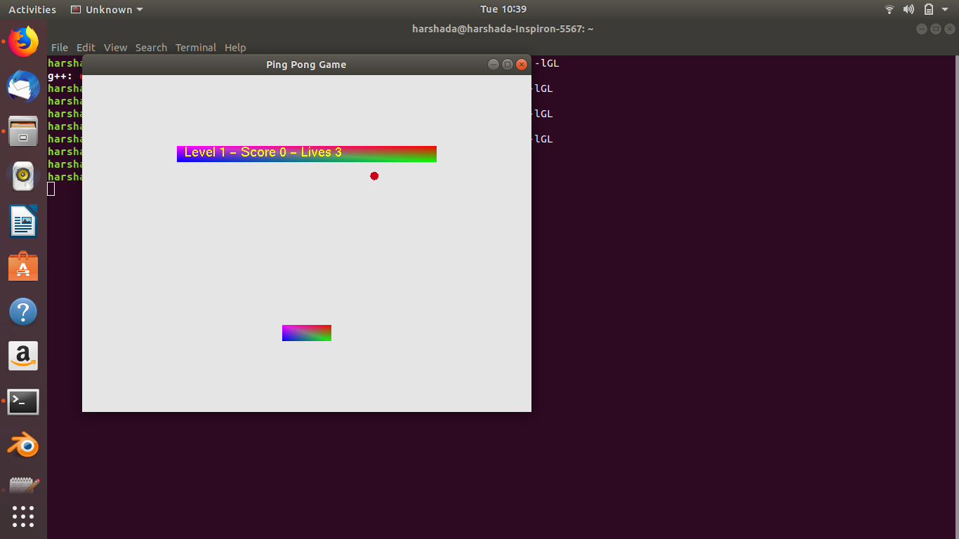
Snapshots

Slide 7
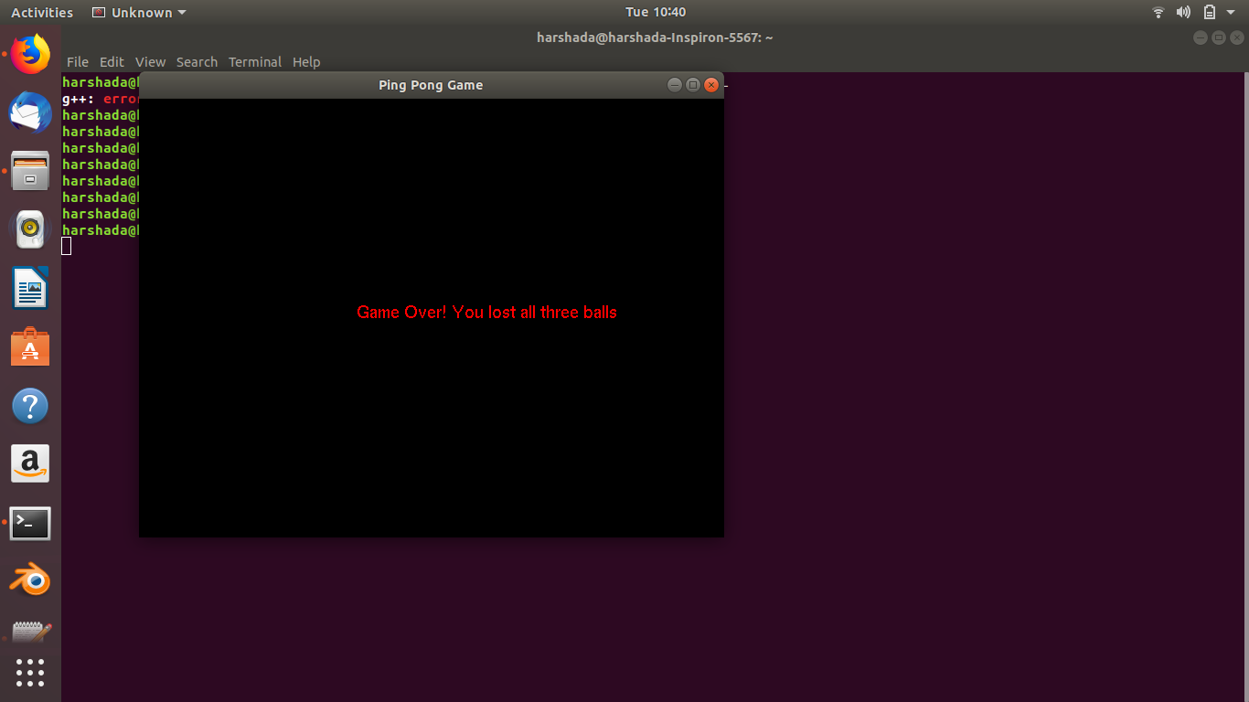
Snapshots

Slide 8
THANK YOU

